Slide 1
Empowering Whisper as a Joint Multi-Talker and Target-Talker
Speech Recognition System
INTERSPEECH2024
Lingwei Meng, Jiawen Kang, Yuejiao Wang, Zengrui Jin, Xixin Wu, Xunying Liu, Helen Men
The Chinese University of Hong Kong, Hong Kong SAR, China
2025.11.02
HyorinJung

Slide 2
Index
Background
Introduction
Analyze & Delineate
  Experiments
    Setting
    Result
Conclusion
Proposal

Slide 3
Background
Prior adaptation methods: Multi-talker speech recognition.
Cascade systems
1)Separate → 2)recognize
suffer from objective mismatch and limited joint optimization
End-to-end (E2E)
ASR methods (PIT, HEAT, SOT) show promise
but usually need training from scratch or full fine-tuning

Slide 4
Background
Prior adaptation methods: Target-Talker ASR.
Goal : Efficiently recognize one target speaker’s speech in multi-talker conditions
End-to-end approaches have shown remarkable progress
Limitation
However, they generally require:
  External modules (e.g., x-vector, ECAPA-TDNN)
  Internal embedding extractors
Usually, only the target speaker’s transcript is produced, while non-target speech is ignored.
Speaker-attributed ASR can handle multiple speakers, but requires embeddings for all speakers
Only one prior work addressed joint multi- and target-talker ASR, but still depends on an external extractor.

Slide 5
Introduction
Main Contributions:
Novel joint ASR framework — transcribes multi-talker speech while highlighting the target speaker without any speaker embedding extractor.
Parameter-efficient & loosely coupled — only a small number of trainable parameters.
State-of-the-art performance on LibriMix / LibriSpeechMix (English) and strong zero-shot generalization on AishellMix (Mandarin)

Slide 6
Introduction
Method
Whisper (Foundation Model) : Serves as the base encoder-decoder model, providing robust pre-trained speech representations
Sidecar Separator : Separates mixed embeddings from multiple speakers within Whisper’s encoder layers
Target Talker Identifier (TTI) : Identifies the target speaker’s embedding flow dynamically using a 3-second enrollment cue
Soft Prompt Embedding : Adapts the Whisper decoder to multi-/target-talker ASR tasks through lightweight soft prompt tuning

Slide 7
Background
Whisper as the Speech Foundation Model
Whisper is an attention-based encoder–decoder speech recognition model.
Trained on massive web-scale labeled speech data
Widely used beyond ASR as a speech foundation model
Inspired by its versatility, this study extends Whisper to handle joint multi-talker and target-talker ASR tasks efficiently

Slide 8
Background
Empowering Whisper as a Multi-Talker ASR System
SS + Whisper >> converts a well-trained single-talker ASR model into a multi-talker ASR model
The SS is a temporal convolutional network inserted between the early encoder layers
It consists of stacked 1-D dilated convolutional blocks inspired by Conv-TasNet.
Since the shallow encoder layers of ASR capture more acoustic than linguistic information, the SS separates mixed embeddings into speaker-specific representations by generating talker-dependent masks.

Slide 9
Background
Placement in Whisper:
The Sidecar Separator, along with two additional 1-D Conv layers, is placed after the 2nd encoder block.
It generates masks corresponding to each speaker,
which are element-wise multiplied with the mixed embeddings to obtain separated speaker embeddings.
The remaining encoder blocks and decoder then process each branch to produce the final transcriptions for each speaker.

Slide 10


Background
Log-Mel Spectrogram
CNN Down-sampling
Encoder
Decoder
Text
s : special token sequence
ex<|PREV|>, decoder prompt, <|SOT|>, <|LANGUAGE|>, <|TRANSCRIBE|>, <|NO-TIMESTAMP|>

Slide 11
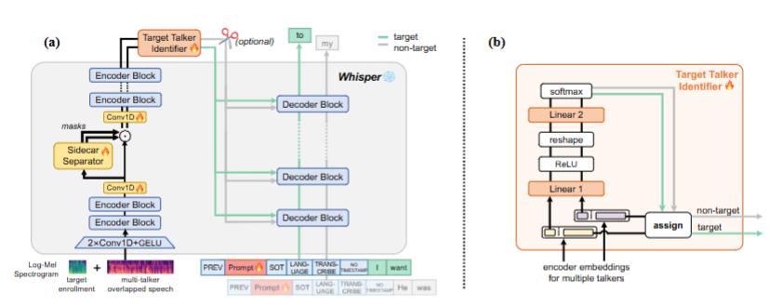

Slide 12
Background
Target Talker Identifier (TTI)
Introduces target-talker ASR capability into the system
During the forward process :
  Encoder outputs (from multiple speakers) are divided into:
    Prefix segment — corresponds to the 3-second enrollment speech
    Main segment — corresponds to the multi-talker speech
The prefix segment is sent to the TTI module,
which determines which branch belongs to the target talker.
Only the main segment of the target branch is passed to the Whisper decoder for transcription.

Slide 13
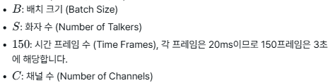
Background
How TTI Works
Step | Operation | Output shape
1 | Prefix segment input | (B × S, 150, C)
2(reshape) | Linear layer + ReLU | (B × S, 150, 1)
3(softmax) | Squeeze(크기1차원 제거) + reshape → Linear + Softmax | Probability (B, S) of each branch being the target speaker
 | Select target branch (highest probability) | Minimal computational overhead

Slide 14
Background
Soft Prompt Tuning
Whisper model text prompt tokens >> prefixes in the decoder input sequence to specify tasks and conditions
Combine this inherent property of Whisper with
Soft Prompt Tuning >> To adapt the model efficiently
for multi-talker and target-talker ASR

Slide 16
Background
How It Works
A learnable embedding (soft prompt) is inserted between
<|PREV|> and <|SOT|> tokens — where hard prompts are usually placed
The position of the soft prompt is masked when calculating loss, since the model doesn’t need to generate it
The soft prompt embedding is updated as the model learns
to transcribe multi-talker speech

Slide 17
Experiments : Setting
Datasets
English datasets:
  LibriMix : 2- and 3-speaker fully overlapped mixtures (Libri2Mix, Libri3Mix)
  LibriSpeechMix : partially overlapped mixtures (random delay)
Mandarin dataset:
  Aishell1Mix : generated from Aishell-1 corpus
Each enrollment speech = 3-second clip randomly sampled from LibriSpeech.
Audio longer than 30 s is time-stretched to fit Whisper’s input limit.

Slide 18
Experiments : Setting
Implementation Details
At each training step:
  80% probability: multi-talker ASR training
  20% probability: joint multi-talker + target-talker ASR training
Two losses are optimized:
  ASR loss
  TTI cross-entropy loss
Both require speaker-order permutation assignment (to resolve label ambiguity)

Slide 19
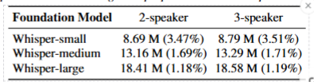
Experiments : Setting
Model Settings and Evaluation Metrics
Base models: Whisper-small, Whisper-medium,Whisper-large-v3
Frozen weights; only train: Sidecar Separator, TTI module, Soft Prompt embeddings
Optimizer: AdamW (lr: 2e-4 → 1e-4)
Training: up to 200k steps on 8×NVIDIA V100 (batch=16)
λ = 0.01 for TTI loss weight.
Evaluation metrics:
  Multi-talker ASR → WER/CER (permutation-based)
  Target-talker ASR → standard WER

Slide 20



Experiments : Setting
Implementation Details
The assignment is determined by Permutation Invariant Training (PIT): matching
Final objective:
λ = 0.01
No CTC loss is used, since Whisper was not trained with CTC.

Slide 21
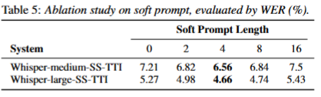
Ablation Study
Ablation:
Tested prompt lengths {0, 2, 4, 8, 16}
Best performance achieved at soft prompt length = 4.
Too long → harder optimization (frozen model → longer sequences hurt)

Slide 22
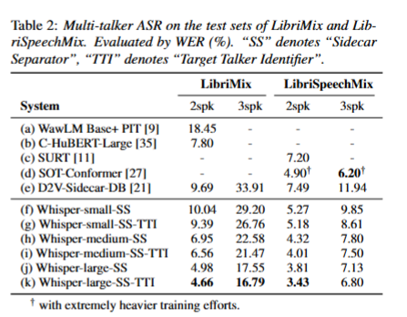

Slide 23
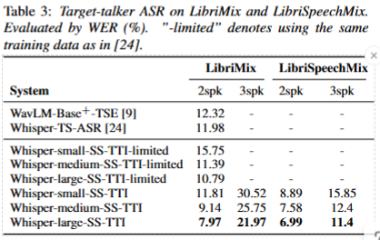

Slide 24
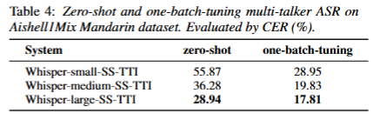

Slide 25
Experiments : Result
Evaluated whether multilingual capability is retained after fine-tuning on English.
Tested on AishellMix (Mandarin) – first use for multi-talker ASR.
Two evaluation modes:
  Zero-shot: directly tested without retraining
  One-batch tuning: fine-tuned for one epoch on AishellMix
Medium & large models show acceptable CER in zero-shot;
further improved with minimal tuning.
Confirms that Whisper’s multilingual ability is preserved

Slide 26
Limitations
Limitations:
Current method relies on PIT, requiring pre-defined max speaker count.
Future work: explore SOT / HEAT to handle variable speakers.
Large target-speaker delay can reduce accuracy.
Plan to enhance TTI with longer contextual awareness (beyond 3 seconds).

Slide 27
Conclusion
We proposed a novel methodology that harnesses Whisper,
a speech foundation model, to jointly transcribe multi-talker speech
while highlighting the target talker’s speech,
without any external speaker embedding extractor.
Key components:
1️⃣ Frozen Whisper backbone
2️⃣ Sidecar Separator for embedding separation
3️⃣ Target Talker Identifier (TTI) for on-the-fly target detection
4️⃣ Soft Prompt Tuning for efficient task adaptation
Extensive experiments show that our approach:
Outperforms previous methods on LibriMix and LibriSpeechMix
Achieves strong zero-shot performance on AishellMix (Mandarin)

